Slide 1
Community Board 9
Thierno Bah
thiernoamadoubah@gmail.com

Slide 2
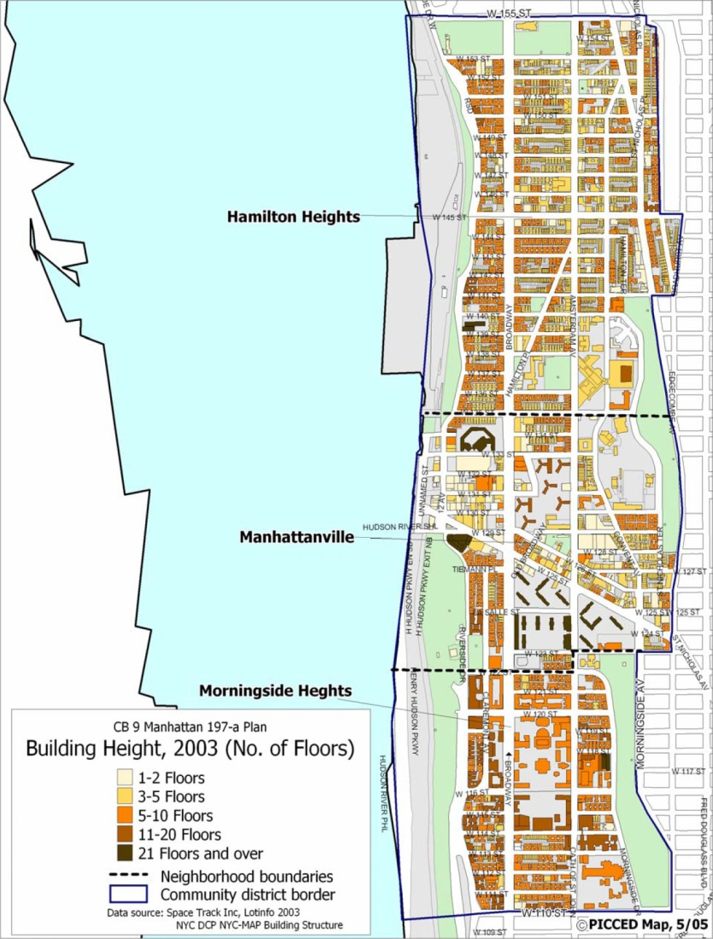
Map of community Board 9

Slide 3
Intro to Community board 9
Manhattan Community District 9 encompasses the West Harlem neighborhoods of Morningside Heights, Manhattanville, and Hamilton Heights.
District Manager: Eutha Prince
Chair: Hon. Padmore John.

Slide 4
Community District Digital Footprint
Website:
The link of community board 9 website is:
http://www.nyc.gov/html/mancb9/html/home/home.shtml.
The address, contact, and office hours of community board 9 is found in the main page of the website.
Community members, staffs, and committees are all
listed in the website.
The website also displays the news and calendar events
Of the community board.

Slide 5
Social Media
Facebook:
The community board 9 is active on facebook .
It posts about educational and employment opportunities.
It also share sport and artistic events taking place in the community board.
Twitter:
The account is inactive since 2012.

Slide 6
Assumptions
Winter: Heat complaints.
Spring: Flood complaints.
Summer: Noise complaints.
Fall: Trash complaints.

Slide 7
Complaints per Season
Winter:

Slide 8
Complaints per Season

Slide 9
Complaints per Season
Spring:

Slide 10
Complaints per Season

Slide 11
Complaints per Season
Summer:

Slide 12
Complaints per Season

Slide 13
Complaints per Season
Fall:

Slide 14
Complaints per Season

Slide 15
Comparison Between winter 2014 vs. winter 2015
Winter 2014:

Slide 16
Comparison Between winter 2014 vs. winter 2015

Slide 17
Comparison Between winter 2014 vs. winter 2015
Winter 2015:

Slide 18
Comparison Between winter 2014 vs. winter 2015

Slide 19
Comparison Between winter 2014 vs. winter 2015
Remarks:
In 2015, there is a twofold increase in the number of complaints regarding heating, plumbing, and noise compared to the previous year.
If this trend continues, we’ll observe a higher increase in these categories in winter 2016.

Slide 20
Heat/Hot Water Service Requests
Months with the most heat/hot water service requests:
According the 311 open data, the months of November to March register the most heat/hot water service requests throughout the year.
The data makes sense as these months are among the coldest in the year.

Slide 21
Heat/Hot Water Service Requests
Repeat Callers:
We observe repeat calls from some addresses that are listed below.
684, 644 riverside drive, 41 Tiennman place, 180 Edgecombe avenue are addresses that have the most repeat calls.

Slide 22
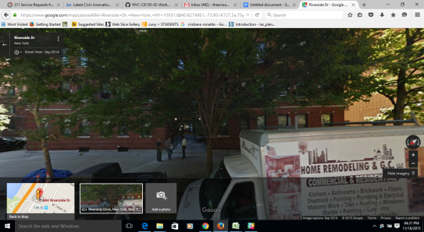
Heat/Hot Water Service Requests
684 Riverside Drive, 539 Calls.
Picture:

Slide 23
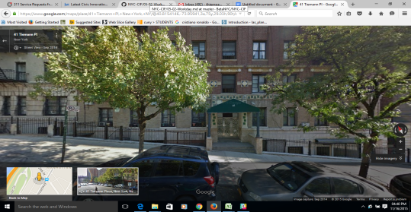
Heat/Hot Water Service Requests
41 Tiemann Avenue, 497 calls.
Picture:
Picture:

Slide 24
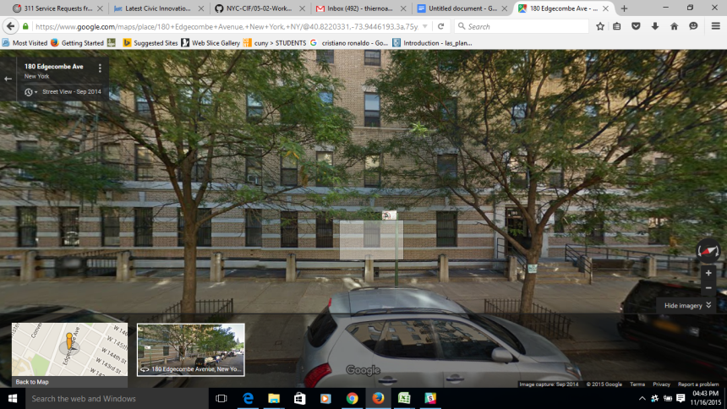
Heat/Hot Water Service Requests
180 Edgecombe Avenue, 445 calls.
Picture:

Slide 25
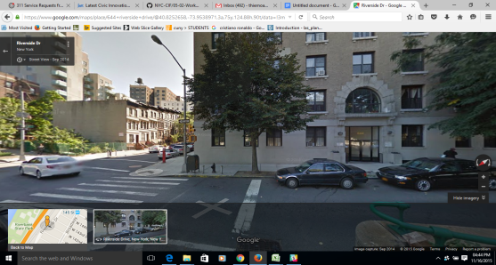
Heat/Hot Water Service Requests
644 Riverside Drive, 437 calls,
Picture:

Slide 26
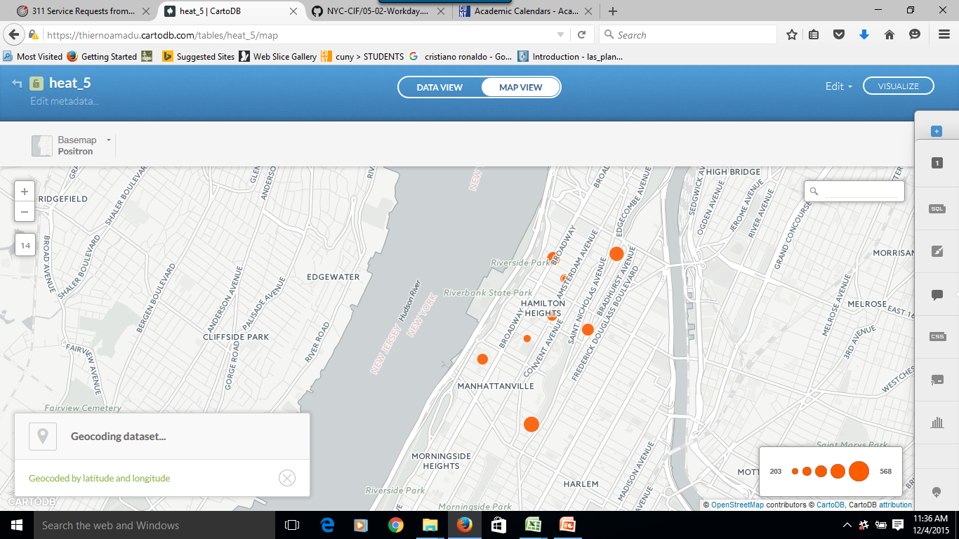
Heat/Hot Water Service Requests

Slide 27
Rodent Service Request
The intersection of Amsterdam Ave./Broadway and Broadway/ Riverside drive are the locations that have the most rodent complaints.
When we look at the pictures above, we see that both areas have subway stations and fast food restaurants around them. This might some of the reasons of the recurrence of complaints.

Slide 28
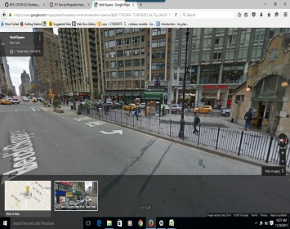
Rodent Complaints Hotspots
Amsterdam Ave./Broadway, 377 complaints.
Picture:

Slide 29
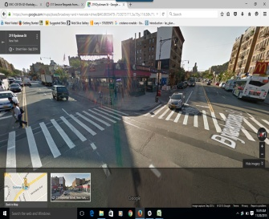
Rodent Complaints Hotspots
Broadway/Riverside Drive, 194complaints.
Picture:

Slide 30
Rodent Service Request
Months with highest Rodent Service Requests:
The data shows that the months between May and October witness an increase in the number of complaints regarding rodents.
This increase may have been caused by the warm weather and abundance of garbage during these months.

Slide 31
Street condition / pothole
Street Condition Descriptors:

Slide 32
Street condition / pothole
top five street condition issues per year:
Cave-In;
Defective Hardware;
Failed Street Repair;
Pothole;
Rough, pitted, or cracked Roads;

Slide 33
Street condition / pothole
Remarks:
When we analyze the table, we observe that the complaints regarding the cave-in condition go dramatically up during the summer season.

Slide 34
Noise Complaints
Top 10 Noise Complaint Types:
Noise: Construction Before/After Hours (NM1)
Noise, Barking Dog (NR5)
Noise: Construction Equipment (NC1)
Noise: air condition/ventilation equipment (NV1)
Noise: Jack Hammering (NC2)
Noise: Alarms (NR3)
Noise, Ice Cream Truck (NR4)
Noise: Private Carting
Noise (NQ1) Noise: lawn care equipment (NCL)
Noise: Manufacturing Noise (NK1)

Slide 35
Noise Complaints
Remarks:
In analyzing the data, we don't observe any seasonal pattern throughout the years in relation to noise service requests.
The only change we can perceive is an overall increase in the number complaints from 2014 upward in comparison to the previous years.

Slide 36
Noise Complaints
Noise Complaints Hotspots:

Slide 37
Illegal parking / blocked driveway Complaints
Remarks:
In observing the data in this table, we don't see complaints pattern by the months as there is no regularity across the years.
The only thing we can notice is that from 2014 upward there is a sharp increase in the number of complaints compared to the previous years.

Slide 38
Illegal parking / blocked driveway Complaints
illegal parking & blocked driveway hot spots:

